Slide 1
Object Oriented Programming and Design
Presented by
Dr Ramya Devi M
mramyadevi@wilp.bits-pilani.ac.in
CS - 13 : 18th Oct 2025

Slide 2

IMP Note to Self

Slide 3
THREADS

Slide 4
Learning Objectives
What is a Process, Process Control Block?
What is Multitasking & What is Mutithreading?
Thread - Definition
Methods of creating a thread
Advantages and Disadvantages of thread
Life Cycle of thread
Definition, merits and demerits of Multithreading
Demonstration program for multithreading
Priorities of threads
Object Oriented Programming

Slide 5
THREADS
What are Java Threads?
A thread is a:
Series of executed statements
Mentioned as a lightweight process
Facility that allows the users to do multiple activities within a single process
Each thread has its own program counter, stack and local variables
It shares memory, files and per-process state
Object Oriented Programming

Slide 6
THREADS
Individual and separate unit of execution that is part of a process
  multiple threads can work together to accomplish a common goal
Video Game example
  one thread for graphics
  one thread for user interaction
  one thread for networking
Video Game
Process
video
networking
interaction
Object Oriented Programming

Slide 7
THREADS
Need for threads
To perform asynchronous processing
Increases the responsiveness of GUI applications
Take advantage of multiprocessor systems
Simplify program logic when there are multiple independent entities
What happens when a thread is invoked?
When a thread is invoked, there will be two paths of execution. One path will execute the thread and the other path will follow the statement after the thread invocation. There will be a separate stack and memory space for each thread.
Object Oriented Programming

Slide 8
THREADS
Risk Factor
Proper co-ordination is required between threads accessing common variables [use of synchronized and volatile] for consistent view of data
Overuse of java threads can be dangerous to program’s performance and its maintainability.
Threads in Java
Java threads facility and API is deceptively simple:
Every java program creates at least one thread [ main() thread ].
Additional threads are created through the Thread constructor or by instantiating classes that extend the Thread class.
Object Oriented Programming

Slide 9
THREADS - Creation
Thread creation in Java
Java permits us to implement thread in two ways. They are
1. Extending the java.lang.Thread class
2. Implementing the java.lang.Runnable Interface
Note: The Thread and Runnable are available in the java.lang.* package
1) By extending thread class
The class should extend Java Thread class.
The class should override the run() method.
Object Oriented Programming

Slide 10
THREADS – Creation by extending Thread class
The functionality that is expected by the Thread to be executed is written in the run() method.
void start(): Creates a new thread and makes it runnable.
void run(): The new thread begins its life inside this method.
Example:
class MyThreadClass extends Thread
{
public void run()
{
System.out.prinltn(“ Executing a thread….”);
}
}
Object Oriented Programming

Slide 11
THREADS – Creation by extending Thread class
public static void main(String aa[ ])
{
MyThreadClass T = new MyThreadClass();
T.start();
}
}
The output for the above code is
Executing a thread….
Object Oriented Programming

Slide 12
THREADS – Creation using Runnable interface
By Implementing Runnable interface
The class should implement the Runnable interface
The class should implement the run() method in the Runnable interface
The functionality that is expected by the Thread to be executed is put in the run() method
Example:
class MyThreadClass implements Runnable
{ public void run()
{
Object Oriented Programming

Slide 13
THREADS – Creation using Runnable interface
System.out.prinltn(“ Executing a thread….”);
}
public static void main(String aa[ ])
{
//implements Runnable
//MyThreadClass T = new MyThreadClass(); extends Thread
MyThreadClass() MTC= new MyThreadClass();
Thread T = new Thread(MTC);
T.start();
}
}
It produces the same output as the previous code
Object Oriented Programming

Slide 14
Extends Thread class vs Implements Runnable Interface?
Extending the Thread class will make our class unable to extend other classes, because of the single inheritance feature in JAVA.
However, this will give us a simpler code structure.
If we implement Runnable, we can gain better object-oriented design and consistency and also avoid the single inheritance problems.
If we just want to accomplish basic functionality of a thread , we can simply implement Runnable interface and override run() method.
But if we want to do something serious with thread object as it has other methods like suspend(), resume(), ..etc which are not available in Runnable interface then we may choose to extend the Thread class.
Object Oriented Programming

Slide 15
Thread Lifecycle Management
start() -> Begins the execution of the thread. The run() method is called automatically by the Java Virtual Machine (JVM).
run() -> Contains the code that defines the thread's behavior. This is overridden in a subclass or by a Runnable.
join() -> Waits for the thread to finish execution.join(long millis)Waits for the thread to finish execution for the specified time (in milliseconds).
join(long millis, int nanos) -> Waits for the thread to finish execution for the specified time with nanosecond precision.
interrupt() -> Interrupts the thread. If the thread is in a waiting or sleeping state, it will throw an InterruptedException.
Object Oriented Programming

Slide 16
Thread Lifecycle Management
isInterrupted() -> Checks if the thread has been interrupted.
stop() (Deprecated) -> Forces the thread to stop execution immediately (unsafe and not recommended).
suspend() (Deprecated) -> Suspends the thread execution (unsafe and not recommended).
resume() (Deprecated) -> Resumes a suspended thread (unsafe and not recommended).
In Java, deprecated means that a method, class, or field is marked as outdated or no longer recommended for use. This does not mean it is removed from the language—it still works—but its use is discouraged because there are better, safer, or more efficient alternatives available.
Object Oriented Programming

Slide 17
Thread Lifecycle Management
stop(): Terminates the thread immediately. Not safe as it may leave shared resources in an inconsistent state.
suspend() and resume(): Temporarily pauses and resumes the thread. Deprecated because they can cause deadlocks if not used carefully.
interrupt(): Politely signals the thread to stop or handle interruption, allowing for safer thread management.
Object Oriented Programming

Slide 18
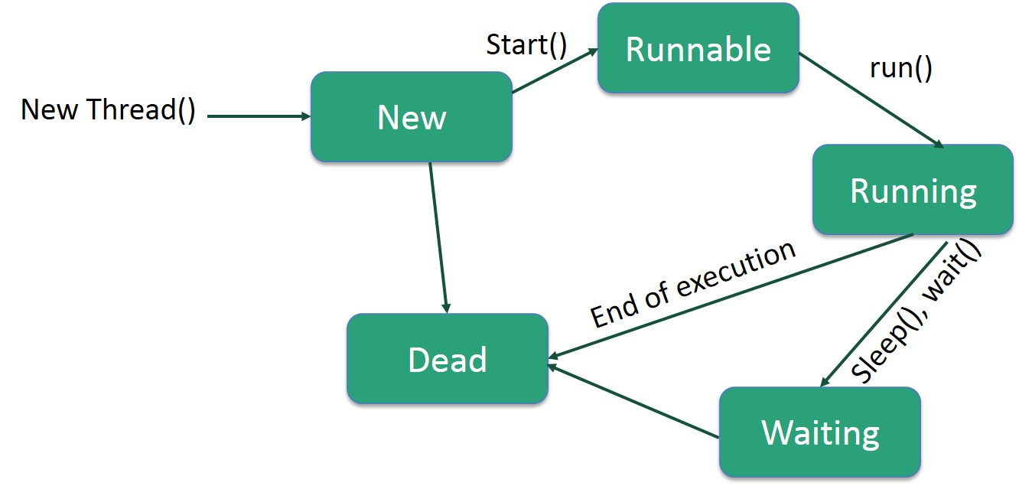
Life Cycle of a thread
Object Oriented Programming

Slide 19
Multithreading in JAVA
Multitasking: Ability to execute more than one task at the same time is known as multitasking.
Multithreading: Multithreading is a technique in which a program (process) is divided into two or more subprograms (subprocesses), each of which can perform different tasks simultaneously (at the same time and in parallel manner). Each subprogram of a program is called thread in Java.
Look at the below figure where a Java program has three threads, one main and two others.
The other two threads ThreadA and ThreadB are created and started from the main thread.
When a program contains multiple flows of control, it is called multithreaded program.
Object Oriented Programming

Slide 20
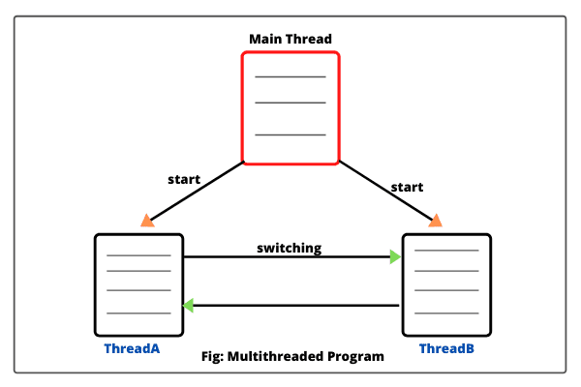
Multithreading in JAVA
Object Oriented Programming

Slide 21
Advantages of Multithreading in Java
The advantages of using multithreading programming concept are as follows:
1. In a multithreaded application program, different parts of the application are executed by different threads concurrently. The entire application does not stop even if an exception occurs in any of the threads. It does not affect other threads during the execution of the application.
2. Different threads are allotted to different processors and each thread is executed in different processors in parallel.
3. Multithreading helps to reduce computation time.
4. Multithreading technique improves the performance of the application.
Object Oriented Programming

Slide 22
Advantages of Multithreading in Java
5. Threads share the same memory address space. Hence, it saves memory.
6. Multithreaded program makes maximum utilization of CPU and keeping the idle time of CPU to minimum.
7. Context switching from one thread to another thread is less expensive than between processes.
Drawbacks of Multithreading in Java
The drawbacks of multithreading are as follows:
1. Increased complexity.
2. Synchronization of shared resources.
3. In the multithreading programming concept, debugging is difficult. At times, result is unpredictable.
4. Potential deadlocks.
Object Oriented Programming

Slide 23
Thread State and Information
getName() -> Returns the name of the thread.
setName(String name) -> Sets the name of the thread.
getId() -> Returns the unique ID of the thread.
getState() -> Returns the current state of the thread (e.g., NEW, RUNNABLE, BLOCKED, WAITING, etc.).
isAlive() -> Checks if the thread is still running.
Object Oriented Programming

Slide 24
Thread priorities
Thread priorities are the integers which decide how one thread should be treated with respect to the others.
Thread priority decides when to switch from one running thread to another, process is called context switching
A thread can voluntarily release control and the highest priority thread that is ready to run is given the CPU.
A thread can be preempted by a higher priority thread no matter what the lower priority thread is doing. Whenever a higher priority thread wants to run it does.
To set the priority of the thread setPriority()method is used which is a method of the class Thread Class.
Object Oriented Programming

Slide 25
Thread priorities
In place of defining the priority in integers, we can use MIN_PRIORITY, NORM_PRIORITY and MAX_PRIORITY
The values of the integers are
MIN_PRIORITY - 1
NORM_PRIORITY - 5
and
MAX_PRIORITY - 10
Methods of Thread Priority:
The following are the methods related to priorities in a thread.
1. public final int getPriority()
It is a method returns priority of given thread.
Object Oriented Programming

Slide 26
Thread priorities
2. public final void setPriority(int newPriority):
It is a method which is used to change the priority of thread to
the value newPriority. This method throws IllegalArgumentException if value of parameter newPriority goes beyond minimum(1) and maximum(10) limit.
Object Oriented Programming

Slide 27
Thread synchronization
Java supports multithreading: multiple threads executing simultaneously.
Threads can share resources (like variables, objects, files).
Problem: When multiple threads access shared resources simultaneously, data inconsistency may occur.
Solution: Thread synchronization ensures only one thread accesses a resource at a time.
Object Oriented Programming

Slide 28
Why Synchronization is Needed
Example of race condition:
  Two threads update the same bank account balance.
  Without synchronization, the final balance may be incorrect.
Synchronization ensures atomicity of operations.
Prevents thread interference and memory consistency errors.
Object Oriented Programming

Slide 29
Synchronization in Java
Java provides synchronization in two ways:
  Synchronized Methods
  Synchronized Blocks
Key Points: Only one thread can execute a synchronized method or block on the same object at a time.
Other threads are blocked until the resource is free.
Object Oriented Programming

Slide 30
Synchronized Method
Java provides synchronization in two ways:
  Synchronized Methods
  Synchronized Blocks
Key Points: Only one thread can execute a synchronized method or block on the same object at a time.
Other threads are blocked until the resource is free.
Object Oriented Programming

Slide 31
Key points
Use synchronized to avoid race conditions.
Prefer synchronized blocks over methods for better performance.
Every object in Java can be used as a lock.
Static synchronized methods lock the class, instance methods lock the object instance.
Object Oriented Programming

Slide 32
Advanced Concepts
Reentrant Locks: java.util.concurrent.locks.
ReentrantLockDeadlock: When two threads wait for each other’s lock indefinitely.
Wait & Notify: Threads can communicate while waiting for a lock.
Object Oriented Programming

Slide 33
Thread Communication in Java – wait() and notify()
Threads sometimes need to communicate when sharing resources.
Example: Producer-Consumer problem
Java provides wait(), notify(), and notifyAll() for thread coordination.
These methods must be called within a synchronized context.
Object Oriented Programming

Slide 34
Why wait() and notify() are needed
A consumer thread may need to wait until the producer produces data.
wait(): Makes the current thread release the lock and wait until notified.
notify(): Wakes up one waiting thread.
notifyAll(): Wakes up all waiting threads.
Object Oriented Programming

Slide 35
Syntax
synchronized(obj) {
obj.wait(); // Thread waits and releases lock
}
synchronized(obj) {
obj.notify(); // Wakes up one waiting thread
}
synchronized(obj) {
obj.notifyAll(); // Wakes up all waiting threads
}
Must be called inside a synchronized block/method.
Thread must own the object's monitor to call these methods.
Object Oriented Programming

Slide 36
Thanks

